Slide 1
Cross User Big data Deduplication
Group 03

Slide 2
Introduction
Motivation
Objectives
Literature Survey
Generalized System Architecture
Feasibility Study
H/W & S/W Requirements
Applications
Flow Diagram
Result
Conclusion
Bibliography
Group 03

Slide 3
Introduction
Data deduplication is the technique of data reduction by breaking streams of data into objects and storing only their first instance on the destination media with maintaining their hash keys and all other similar occurrences maintained by respective references
Performs deduplication of data for multiple users in order to achieve uniqueness of textual data only.
This application mainly focuses upon efficient data access, preserve the privacy of textual data against brute-force attacks & manage storage space effectively by avoiding redundancy of data.
Group 03
Notes:
Today’s world has been digitalized to a large extent. The total amount of data generated per day is more than 2.5 exabytes out of which social media fuels up with maximum contribution along with business transactional data, sensor-generated data.
Such a huge amount of data must be managed properly to use it for certain business domain-specific decision-taking purposes. It is very burdensome to store and manage such huge amounts of data which is mostly redundant in nature and that too present over multiple cloud platforms for multiple users; it requires high resources including their cost required to store, backup time, processing time; which results into reduction of system throughput.
So, Data Deduplication is the most preferable way that we propose here considering the above issue. Data deduplication is the technique of data reduction by breaking streams of data into objects and storing only their first instance on the destination media with maintaining their keys and all other similar occurrences maintained by respective references.
We propose a model that will perform deduplication of data for multiple users to achieve the uniqueness of textual data uploaded by multiple users; data access must be efficient, maintain the privacy of data against brute-force attacks. This intension will be achieved by employing certain algorithms like a blocking algorithm & Encryption algorithm and effective data organization. It will not only preserve the space by means of reducing storage allocation but also effectively manage network bandwidth.

Slide 4
Motivation
Nowadays due to the exponential growth in use of emerging technology such as cloud computing and big data, the rate of data growth is also increasing rapidly.
Every second millions of data is being generated because of the use of different new technologies like IOT and Sensor.
It is very challenging to store and handle such large amount of data & get some useful business insights.
This is where we have come up with our solution to address this issue.
Group 03

Slide 5
Objectives
To Prevent Data Redundancy.
To Preserve The Privacy Of Data Among Multiple Users & Maintain Security.
Efficient Data Storage & Its Access.
Group 03

Slide 6
Literature Survey
Sr. No. | Title | Authors | Technique Used | Methodology
1 | Hadoop Based Scalable Cluster Deduplication for Big Data | Qing Liu,Yinjin Fu, Guiqiang Ni | Fixed size blocking Algorithm, Map reduce and HDFS. | They have used Mapreduce technique for parallel deduplication framework. Index table is distributed in each node which is stored in light weight local MySQL databases.
2 | Bucket Based Data Deduplication Technique for Big Data Storage System | Naresh Kumar, Rahul Rawat,S. C. Jain | Fixed Size blocking Algorithm, Bucket based technique | Buckets are used to store the Hashvalue of blocks. Map reduce technique applied to compare hashes stored in bucket with incoming hash of block.
 |  |  | Variable size blocking / Sentence level blocking Partitioning of data in clusters stored in persistent storage & every cluster will satisfy certain characteristic property unique & independent; test cypher text will be classified accordingly the function satisfies.
Group 03
6

Slide 7
3 | A Study on Data Deduplication Techniques for Optimized Storage | E. Manogar, S. Abirami | Location based deduplication, Time based deduplication, Chunk based deduplication | They have mainly discussed the various deduplication techniques. Among them, it has been concluded that variable size data deduplication is well and good when compared to other strategies by comparing the hash of each and every chunk
4 | Authorized Data Deduplication Using Hybrid Cloud Technique | Mane VIdya Maruti, Mininath K.Nighot | Content level Deduplication, file level Deduplication | Duplication is checked in authenticated way. Proof of ownership is needed to file duplication check. User is needed to submit the file and proof of ownership of the file before sending the request for duplicate check request to cloud.
Group 03

Slide 8
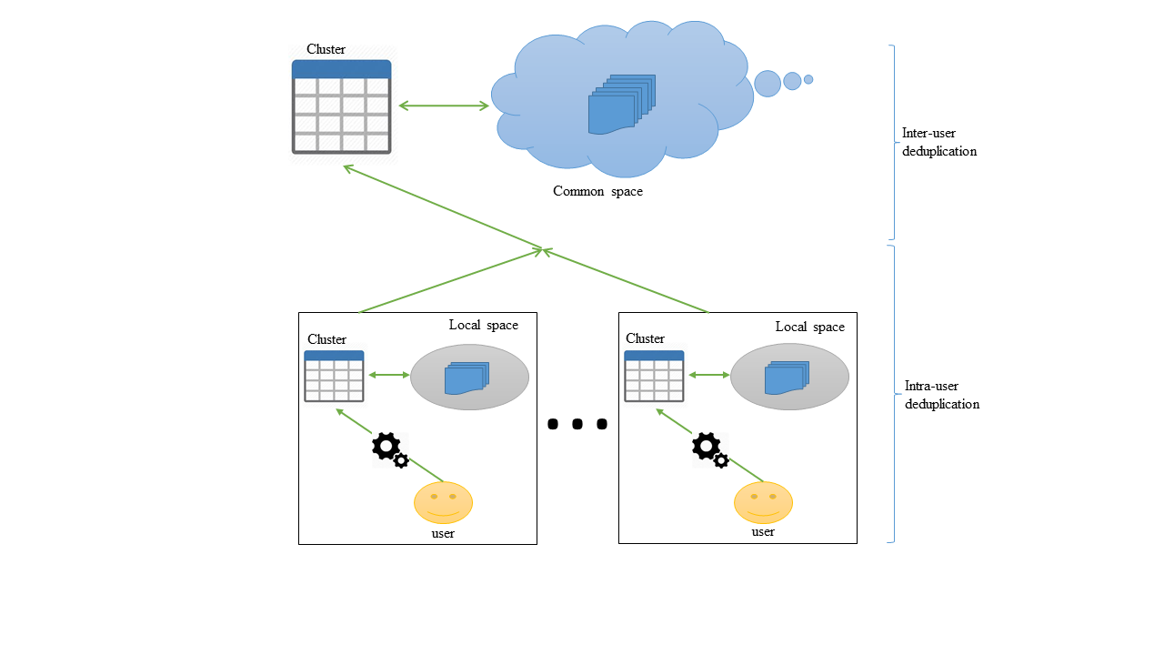
Generalized System Architecture
Group 03

Slide 9
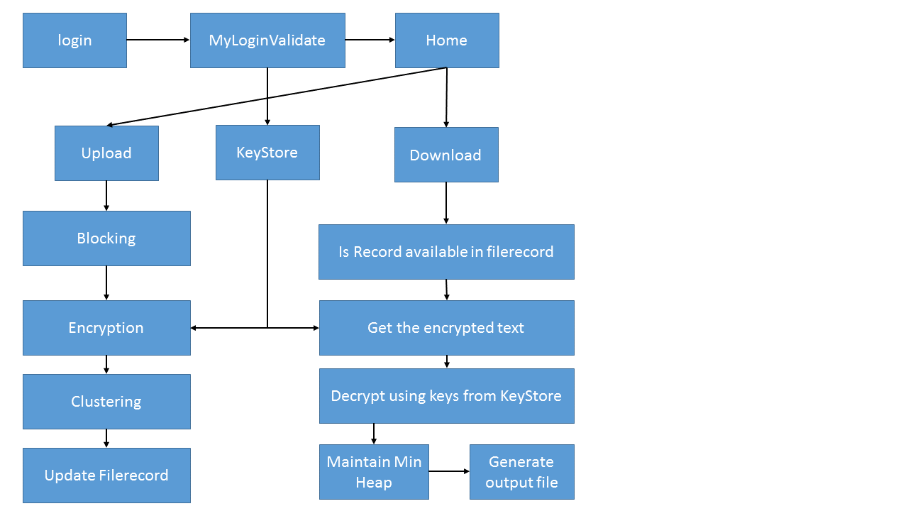
Group 03

Slide 10
Feasibility Study
Technical Feasibility
As for our technical requirements, we are working on Windows 10 OS, Netbeans IDE for Java, 1 TB persistent storage for file system database & Intel Core i5 9th Gen Processor. At college level, we are abide by the resources availability & yet our project is feasible to be performed using above mentioned resources at comparatively less but a considerable scale.
Operational Feasibility
Our data organization is so effective that it makes the data searching much more feasible than the traditional approaches. Our project is about Space but simultaneously it takes care of Time as well which is required to perform operations.
Economical Feasibility
We are making use of system’s persistent storage rather than building our own cloud which costs in billions. This makes it cost effective & affordable as a college level project. Rest of the costing includes technical requirements.
NBN Sinhgad School of Engineering
2019-20 Sem 1
Group 03

Slide 11
H/W S/W Requirements
H/W Requirements
Min 8 GB RAM
Min 1 TB HDD/SSD
S/W Requirements
OS Windows 10
Netbeans IDE
JDK
Libraries like Binary Encoder for AES
Java KeyStore
SQL
Server
NBN Sinhgad School of Engineering
2019-20 Sem 1
Group 03

Slide 12
Applications
Banking Sector
Plagiarism Checker
Business Holders
NBN Sinhgad School of Engineering
2019-20 Sem 1
Group 03

Slide 13
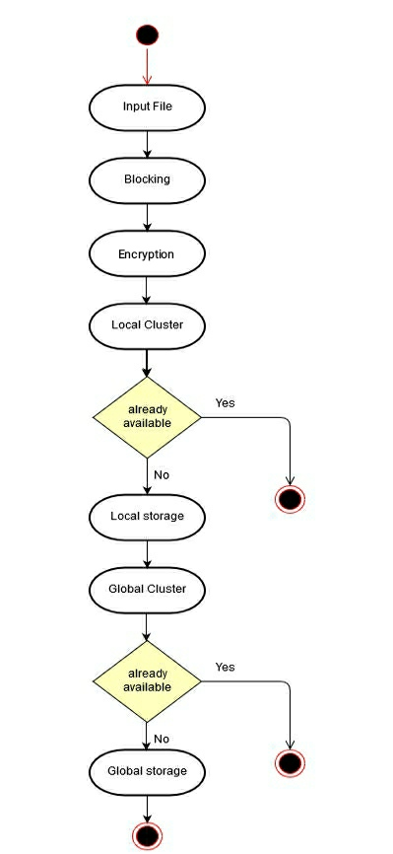
Flow Diagram
Group 03

Slide 14
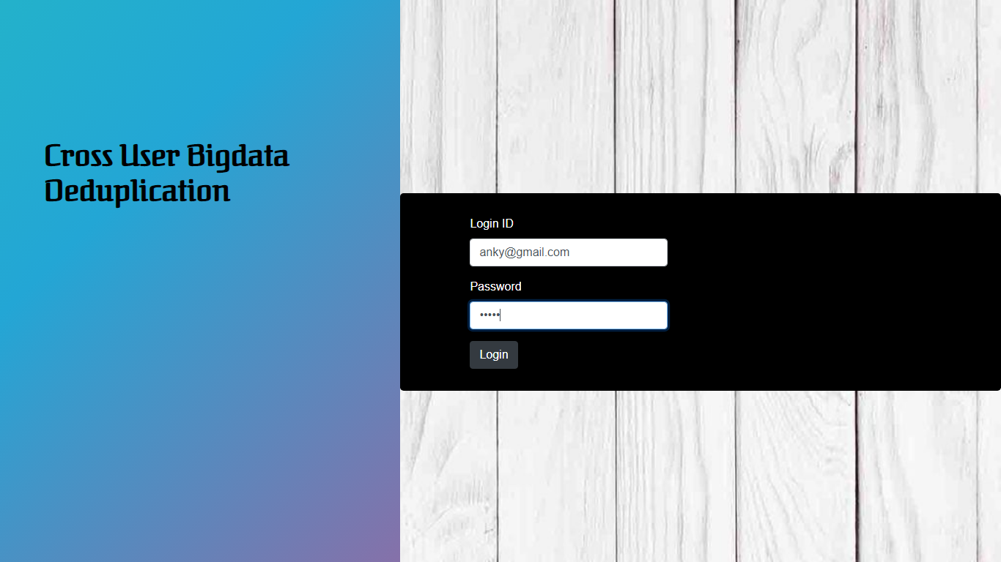
Result
Group 03

Slide 15
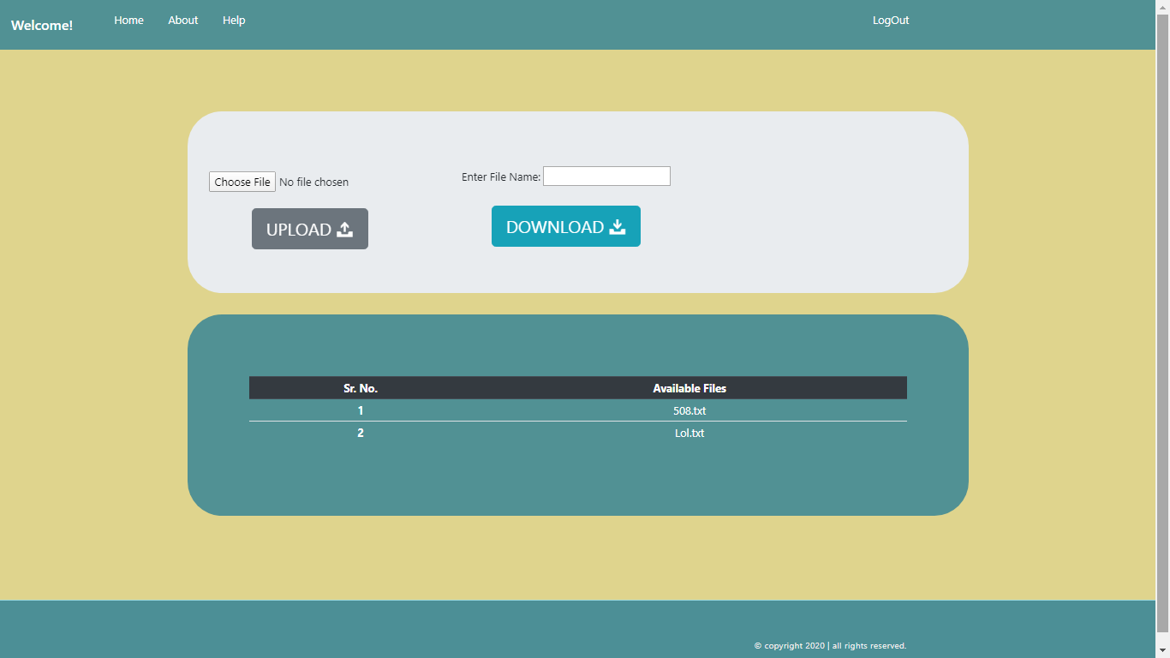
Group 03

Slide 16
Conclusion
We have proposed a cross user bigdata deduplication system to maintain the uniqueness of textual data generated by multiple sources & owned by multiple users. Since the amount of data getting generated is tremendous; hence it becomes challenging to handle & process such huge data for knowledge discovery purposes. This system mainly focuses on redundancy issues; moreover, it also achieves efficient data organization & access, preserves privacy & maintains security. For that, we’ve made use of the Sentence level variable size blocking algorithm and Encryption algorithm to generate crypto keys.
Group 03

Slide 17
Bibliography
C. Liu, Y. Lu, C. Shi, et al., ”ADMAD: Application-driven metadata aware deduplication archival storage System”, in Proc. 5th IEEE Int. Workshop Storage Netw. Archit. Parallel I/Os, 2008, pp. 29–35.7.
Deepavali Bhagwat, Kave Eshghi,Darrell D. E. Long, ”Extreme Binning: Scalable, Parallel Deduplication for Chunkbased File Backup”, in Proc. IEEE Int. Symp. Modell. Anal. Simulation Comput. Telecommun. Syst., 2009, pp. 1–9.
Hyungjune Shin, Dongyoung Koo†, Youngjoo Shin, and Junbeom Hur, “Privacy-preserving and Updatable Block-level Data Deduplication in Cloud Storage Services”, IEEE 11th International Conference on Cloud Computing, 2018.
M. Miao, J. Wang, H. Li, and X. Chen, “Secure multi-server-aided data deduplication in cloud computing,” Pervasive and Mobile Computing, vol. 24, pp. 129–137, 2015
Mane VIdya Maruti, Mininath K.Nighot, “Authorized Data Deduplication Using Hybrid Cloud Technique”, 2015 International Conference on Energy Systems and Applications (ICESA 2015), 2015
NBN Sinhgad School of Engineering
2019-20 Sem 1
Group 03

Slide 18
Thank You!!!
Group 03

